Slide 1
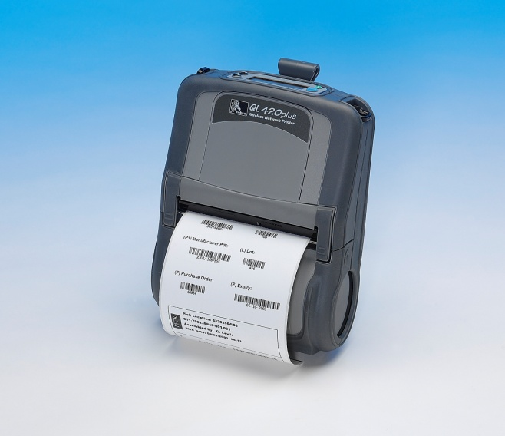
CPCL Overview
JULY 2010
by
Helen Rios

Slide 2
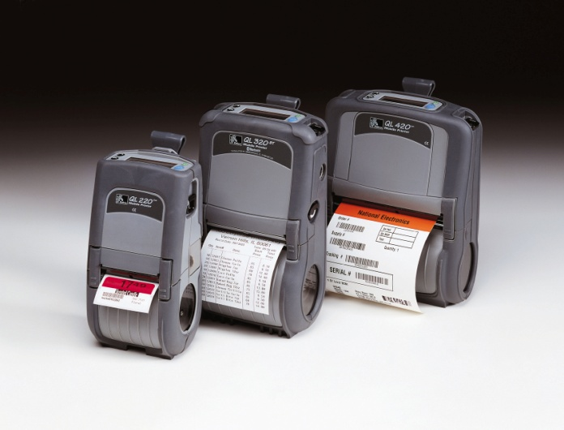
Introduction
Command formats and most common commands used
Examine how the language is setup
Samples
Graphics
Creating format files
Line Print for receipt printing
Set, Get, Do

Slide 3
Format
<!> {offset} <200> <200> {height} {qty}
where:
<!>: Use '!' to begin a control session.
{offset}: The horizontal offset for the entire label.
This value causes all fields to be offset horizontally by the specified number of UNITS.
<200>: Horizontal resolution (in dots-per-inch).
<200>: Vertical resolution (in dots-per-inch).
{height}: The maximum height of the label.
The maximum label height is calculated by measuring from the bottom of the first black bar (or label gap) to the top of the next black bar (or label gap). Then 1/16” [1.5mm] is subtracted from this distance to obtain the maximum height. (In dots: subtract 12 dots on 203 d.p.i printers; 18 dots on 306 d.p.i. printers)

Slide 4
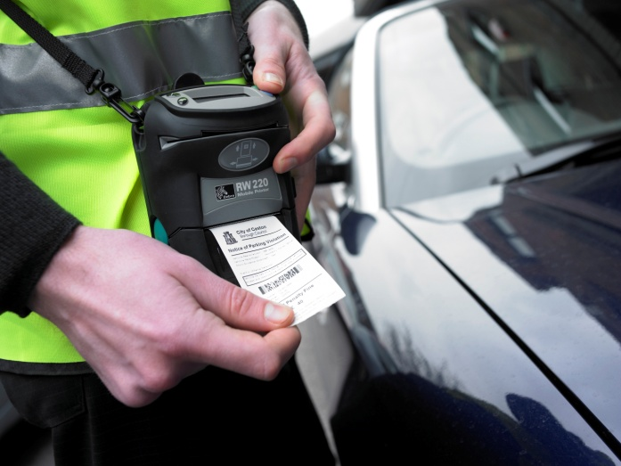
Text
{command} {font} {size} {x} {y} {data}
Where:
{command} : TEXT or T, VTEXT or VT, TEXT90 or T90, TEXT180 or T180, TEXT270 or T270
{font}: Name/number of the font.
{size}: Size identifier for the font.
{x}: Horizontal starting position.
{y}: Vertical starting position.
{data}: The text to be printed.

Slide 5
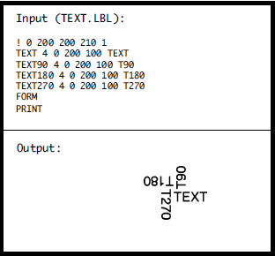

Text
{command} {font} {size} {x} {y} {data}

Slide 6
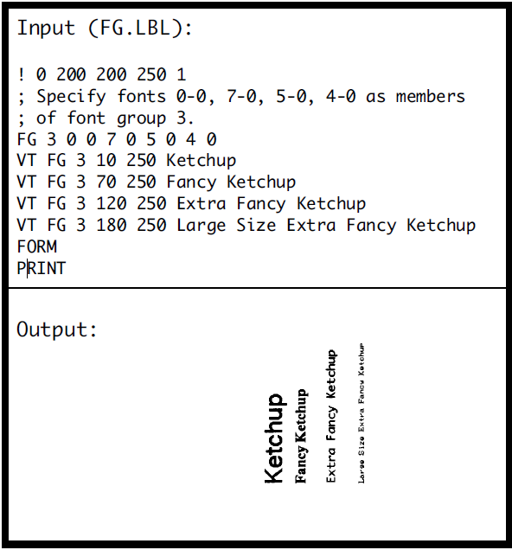
Font Groups
{command} {fg fn fs} [fn fs] ...
{command}: FG
{fg}: Font group number. Up to 10 font groups can be specified. Valid font groups range from 0 to 9.
{fn}: Name/number of the font.
{fs}: Size identifier for the font.
NOTE: Up to 10 font number/font size pairs can be assigned to a font group.

Slide 7
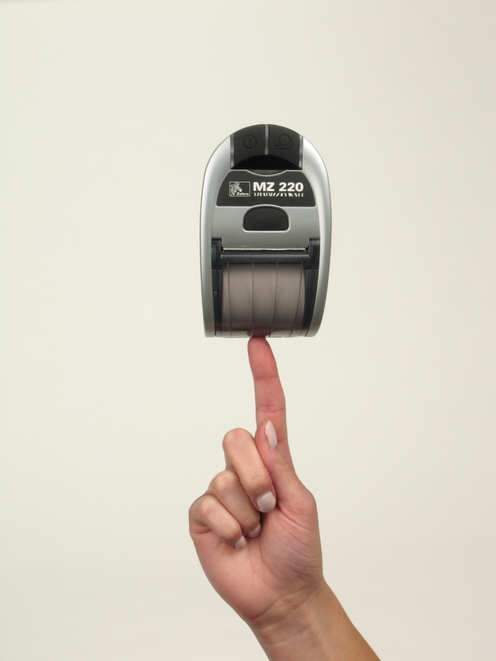
Text Concatenation
Text concatenation allows you to assign different character styles to strings, printing them with uniform spacing on the same text line. This command can be used in combination with scalable fonts. See Scalable Concatenation Commands

Slide 8
Text Concatenation (continued)
Format:
{command} {x} {y}
{font} {size} {offset} {data}
“ “ “ “
{font} {size} {offset} {data}
<ENDCONCAT>
where:
{command}: Choose from the following:
CONCAT Horizontal concatenation.
VCONCAT Vertical concatenation.
{x}: Horizontal starting position.
{y}: Vertical starting position.
{font}: Name/number of the font.
{size}: Size identifier for the font.
{offset}: Unit-value to offset text from the
starting position. Used to align
individual text strings or create
superscript/subscript characters.
{data}: Text to be printed.
<ENDCONCAT>: Terminates concatenation

Slide 9
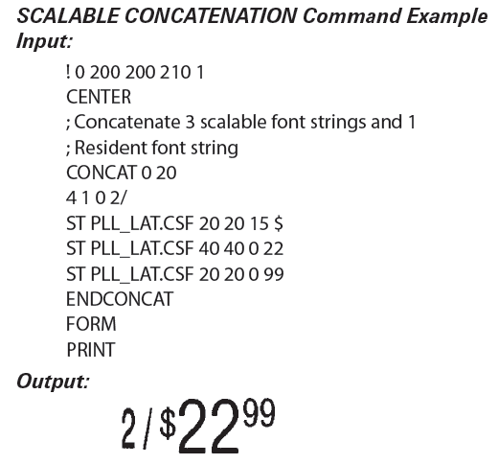

Slide 10
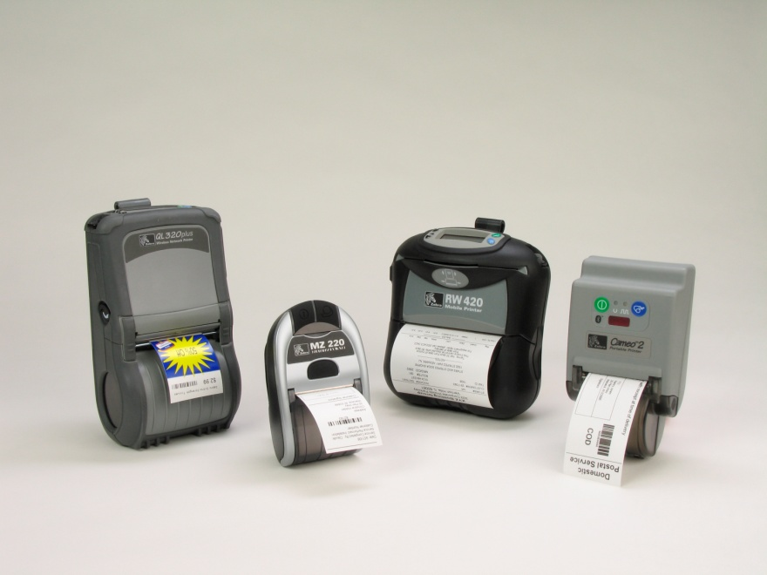
Multi-line (ML) Command
MULTILINE (ML) allows you to print multiple lines of text using the same font and line-height.
Format:
{command} {height}
{text} {font} {size} {x} {y}
{data}
“
{data}
<ENDMULTILINE>

Slide 11
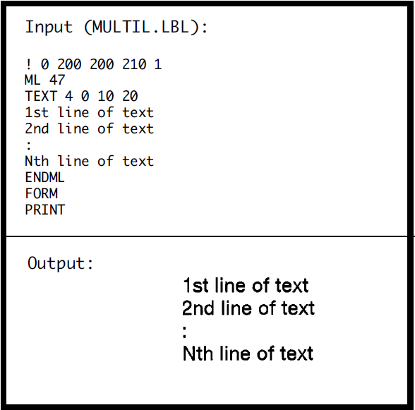
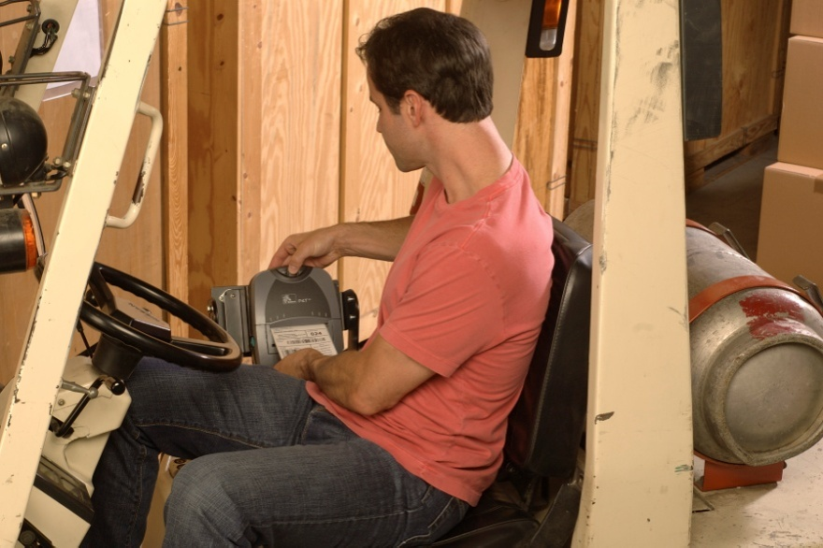
Multi-line (ML) Sample

Slide 12
Count Command
The COUNT command is used for printing multiple labels where a numeric text field or numeric data encoded in a bar code is to be incremented or decremented for each label. The TEXT/BARCODE command string must contain this numeric data as the last characters of the string. The numeric data portion can be up to 20 characters, and can be preceded by the '-' sign. Incrementing or decrementing the numeric data thru '0' is not allowed. Leading zeros will be retained. Up to 3 COUNT commands can be used in a label file. The numeric data incremented/decremented is contained in the TEXT or BARCODE command that immediately preceded the COUNT command.

Slide 13
Count Command (continued)
Format:
{command} {numeric value}
where:
{command}: COUNT
{numeric value}: Any integer value up to 20 characters.
The value can be preceded by a '-' sign if decrementing of the TEXT/BARCODE value is desired. Leading zeros will be retained in the output.

Slide 14
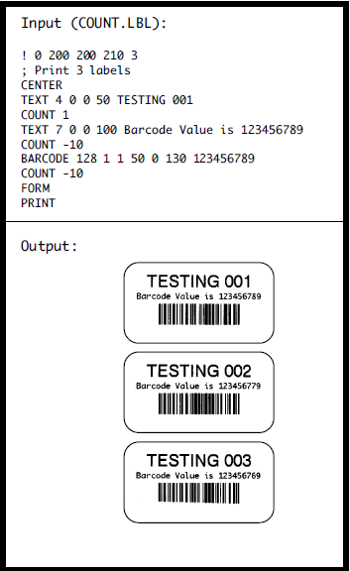

Count Command (continued)

Slide 15
Barcode Command (Cont.)
The BARCODE command prints bar codes in both vertical and horizontal orientations at specified widths and heights.
Format:
{command} {type} {width} {ratio} {height} {x} {y} {data}

Slide 16
Barcode Command (Cont.)
{command}: Choose from the following:
BARCODE Prints bar code horizontally. ( or B)
VBARCODE Prints bar code vertically. (or VB)
{type}: Choose from the following table:
Symbology:
  UPC-A UPCA, UPCA2, UPCA5
  UPC-E UPCE, UPCE2, UPCE5
  EAN/JAN-13 EAN13, EAN132, EAN135
  EAN/JAN-8 EAN8, EAN82, EAN 85
  Code 39 39, 39C, F39, F39C
  Code 93/Ext. 93 93
  Interleaved 2 of 5 I2OF5
  Interleaved 2 of 5 I2OF5C
  with checksum
  German Post Code I2OF5G
  Code 128 (Auto) 128
  UCC EAN 128 UCCEAN128
  Codabar CODABAR, CODABAR16
  MSI/Plessy MSI, MSI10, MSI1010, MSI1110
  Postnet POSTNET
  FIM FIM
{width}: Unit-width of the narrow bar.
{ratio}: Ratio of the wide bar to the narrow bar.
Refer to the table in Appendix “E” for appropriate
settings.
0 = 1.5 : 1 20 = 2.0:1 26 = 2.6:1
1 = 2.0 : 1 21 = 2.1:1 27 = 2.7:1
2 = 2.5 : 1 22 = 2.2:1 28 = 2.8:1
3 = 3.0 : 1 23 = 2.3:1 29 = 2.9:1
4 = 3.5 : 1 24 = 2.4:1 30 = 3.0:1
25 = 2.5:1
Note: The ratios in the Appendix are suggested for best results, however any ratio can be assigned.
{height}: Unit-height of the bar code.
{x}: Horizontal starting position.
{y}: Vertical starting position.
{data}: Bar code data.

Slide 17
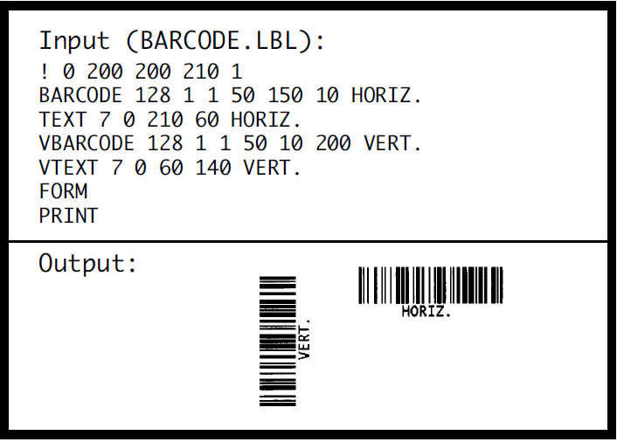
Barcode Command (Cont.)

Slide 18
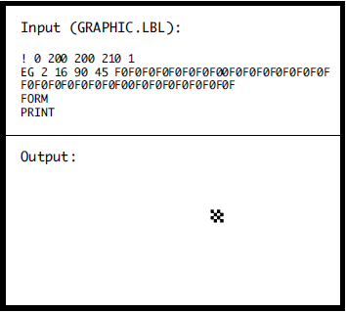
Graphics
Bit-mapped graphics can be printed by using graphics commands. ASCII hex (hexadecimal) is used for expanded graphics data . Data size can be reduced to one-half by utilizing the COMPRESSEDGRAPHICS commands with the equivalent binary character(s) of the hex data.
Format:
{command} {width} {height} {x} {y} {data}
where:
{command}: Choose from the following:
EXPANDED-GRAPHICS Prints expanded (or EG) graphics horizontally.
VEXPANDED-GRAPHICS Prints expanded (or VEG) graphics vertically.
COMPRESSED-GRAPHICS Prints compressed (or CG) graphics horizontally.
VCOMPRESSED-GRAPHICS Prints compressed (or VCG) graphics vertically.
{width}: Byte-width of image.
{height}: Dot-height of image.
{x}: Horizontal starting position.
{y}: Vertical starting position.
{data}: Graphics data.

Slide 19
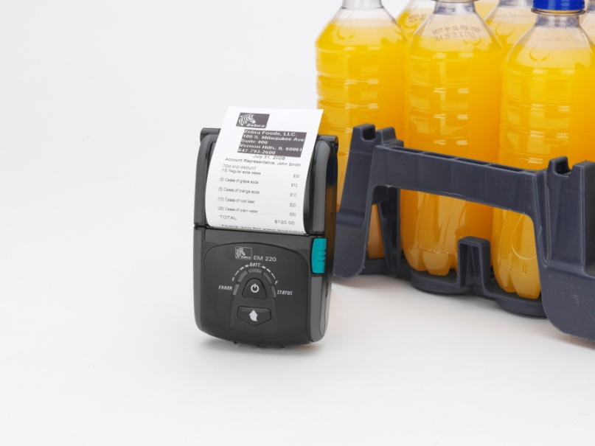
Graphics
PCX Commands
The PCX command gives a user the ability to send ".PCX" graphics formatted images to the printer. The .PCX image MUST be encoded as a black and white image.
Format:
{command} {x} {y}
{data}
where:
{command}: PCX
{x}: X-coordinate of the top-left corner.
{y}: Y-coordinate of the top-left corner.
{data}: PCX image data.

Slide 20
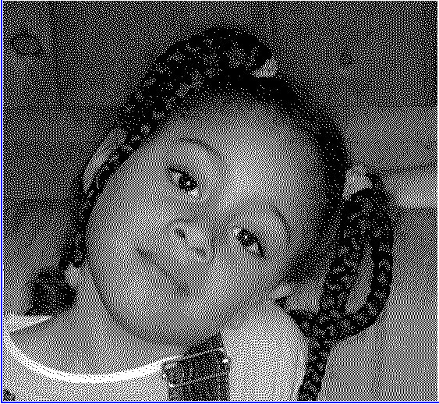
Graphics
In this example , the PCX image has been loaded into the printer’s flash file system and given the name
“Bri1.PCX”. The “!<“ operator can now be used to instruct the printer to get the data stored in the file “Bri1.PCX” and use it for building the image.
Output:
! 0 200 200 500 1
PCX 0 30 !<Bri1.PCX
FORM
PRINT

Slide 21
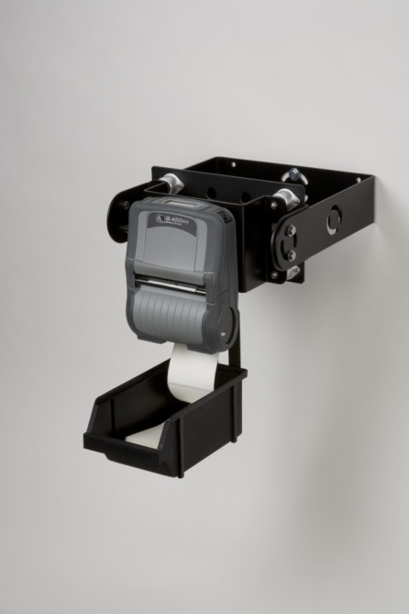
Other Commands
! 0 200 200 210 1
PW 609
SPEED 2 ; range is 0 and 5, 0 being the slowest
TONE 100 ; range is -99 to 200
CENTER
TEXT 4 0 0 75 C
LEFT
TEXT 4 0 0 75 L
RIGHT 383
TEXT 4 0 0 75 R
OUTPUT: L C R

Slide 22

Using Formats
Input (FORMATF.LBL):
! DF SHELF.FMT
! 0 200 200 210 1
CENTER
TEXT 4 3 0 15 \\
TEXT 4 0 0 95 \\
BARCODE UPCA 1 1 40 0 145 \\
TEXT 7 0 0 185 \\
FORM
PRINT
Input (FORMATD.LBL):
! UF SHELF.FMT
$22.99
SWEATSHIRT
40123456784
40123456784

Slide 23
SETLP Command
! U1 SETLP {font name or number} {size} {unit height}
You can use resident fonts or pre-scaled fonts
You have to create a separate line for each font that is different
Each line must be followed by a CRLF
SETLF Command
! U1 SETLF {unit height}
Use the SETLF command to change the height of each line without changing the font.
The command “! U1 SETLF 40” will advance the paper 40 dots for every LF (line feed).

Slide 24
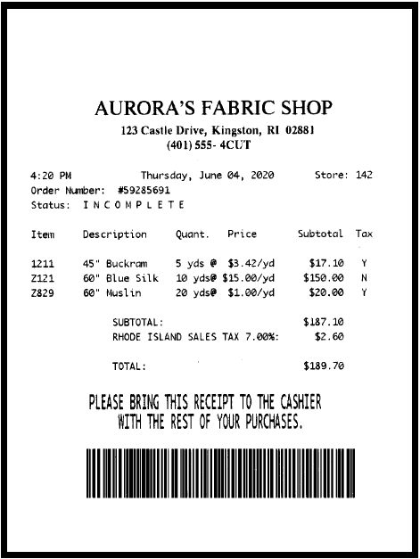
Line Print
! U1 JOURNAL
! U1 SETLP 5 2 46
AURORA’S FABRIC SHOP
! U1 SETLP 5 0 24
123 Castle Drive, Kingston, RI 02881
(401) 555-4CUT
! U1 SETLP 7 0 24
4:20 PM Thursday, June 04, 2020 Store: 142
Order Number: #59285691
Status: ! U1 SETSP 10
INCOMPLETE ! U1 SETSP 0
Item Description Quant. Price Subtotal Tax
1211 45" Buckram 5 yds @ $3.42/yd $17.10 Y
Z121 60" Blue Silk 10 yds@ $15.00/yd $150.00 N
Z829 60" Muslin 20 yds@ $1.00/yd $20.00 Y
SUBTOTAL: $187.10
RHODE ISLAND SALES TAX 7.00%: $2.60
TOTAL: $189.70
! U1 SETLP 7 1 48
PLEASE BRING THIS RECEIPT TO THE CASHIER
WITH THE REST OF YOUR PURCHASES.
! U1 CENTER
! U1 B 128 1 2 100 0 0 59285691 ST 187.10 T 2.60

Slide 25
Set, Get, Do

Slide 26
setvar
The “setvar” command is used to set parameter values in the printer.
Format:
Setvar “{parameter name}” “{Value}”
Samples:
! U1 setvar "media.sense_mode" “gap“
! U1 setvar "media.sense_mode" “journal“
! U1 setvar "bluetooth.authentication" "setpin"
! U1 setvar “bluetooth.bluetooth_pin” “6789”
SET "^XZ"="^MCY^XZ“
SET “^PW203” = “PW406”

Slide 27
Get
The “getvar” command is used to get the current value of the printer parameters. If you use a value that is not in the printer, then you will get a “?” as a result. Parameters names are in lower case.
Examples:
! U1 getvar "zpl.print_orientation“ {choices are “inv” or “nor”}
! 0 200 200 150 1
CENTER
! U1 getvar “file.dir”
T 5 0 10 10 File directory contents is !<file.dir
PRINT

Slide 28
Do
This command tells the printer to execute a command.
Examples:
! U1 do “file.print” “config.sys”
! U1 do “file.rename” “config.sys run.bat”
! U1 do “file.run” “test.bat”

Slide 29
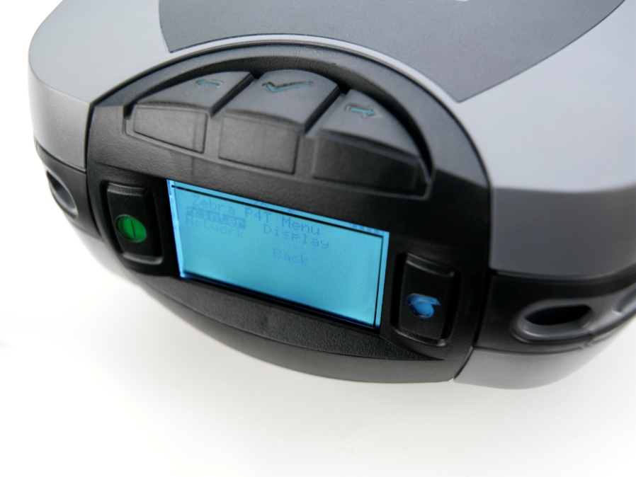
Summary
Text
Font groups and concatenation
Special commands
Barcode commands
Graphics
Recalling formats
Line print mode
Set, Get Do

Slide 30
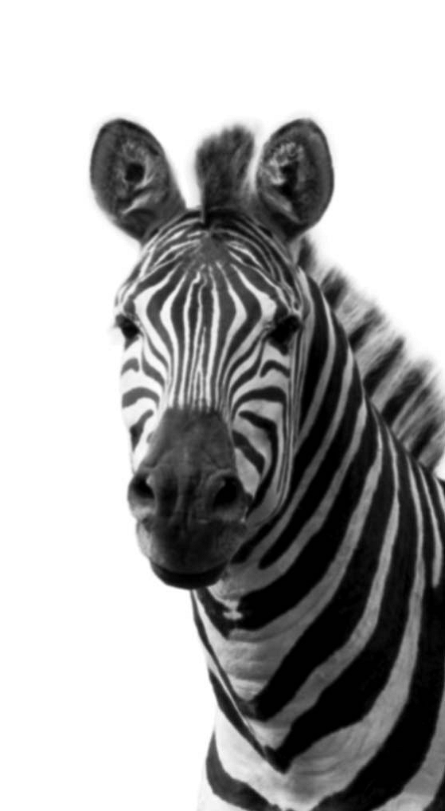
Questions?

